Slide 1


Slide 2
Meaning
Benefit
Sketch of the question
Data analysis
Data visualization
Model
Evaluate Model
Demo

Slide 3
Meaning and Benefit

Slide 4
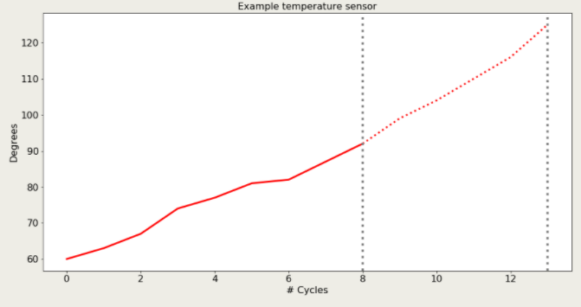
Sketch of the question
Can we forecast the temperature of the future time-points?
Can we predict how long the time-serie continues until a pre-defined event happens?

Slide 5
Data analysis
Missing values
Outliers and flat lines
Groupby
Scaling
View Correlate

Slide 6
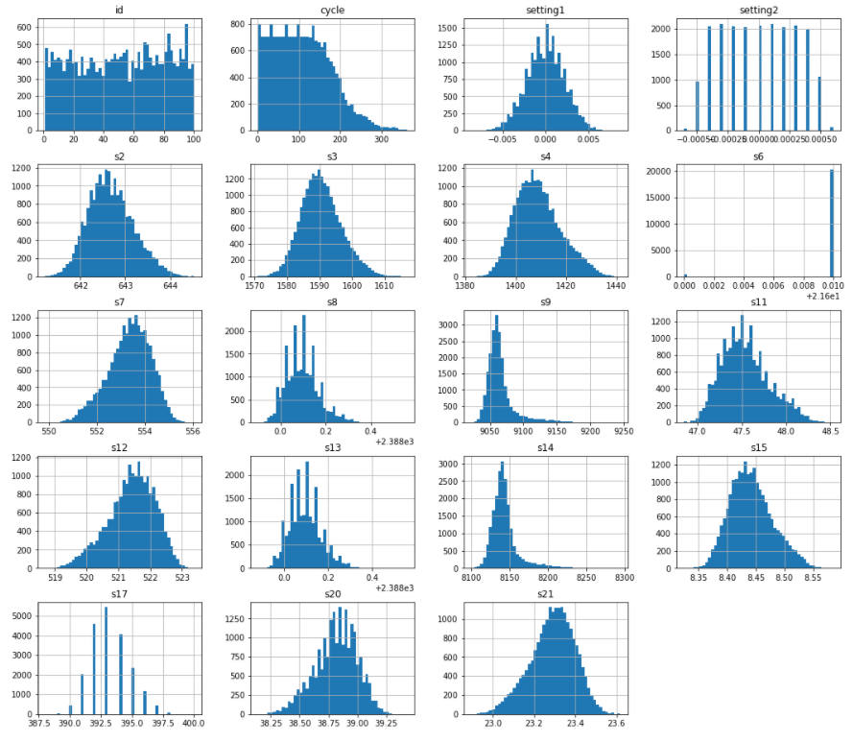
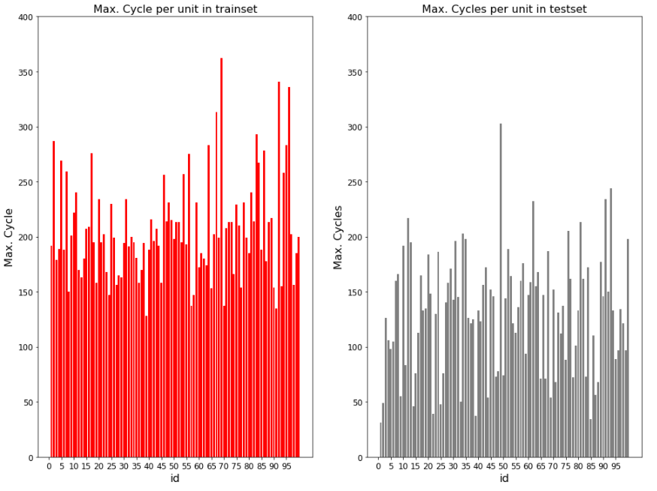
Data visualization

Slide 7
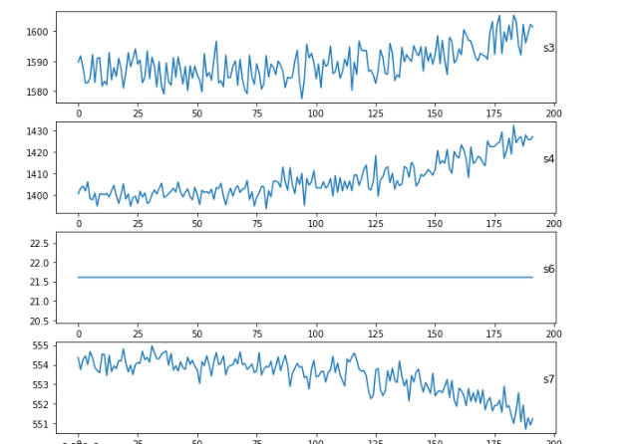
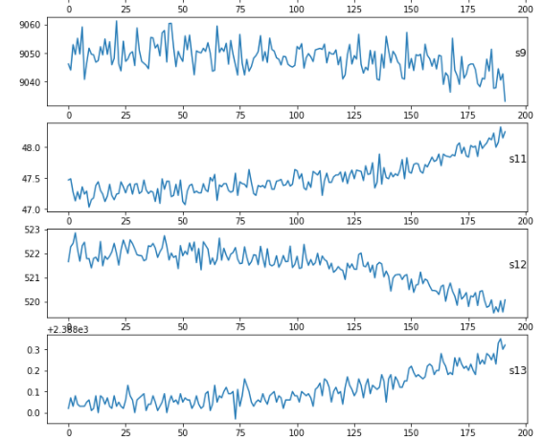
Data visualization

Slide 8
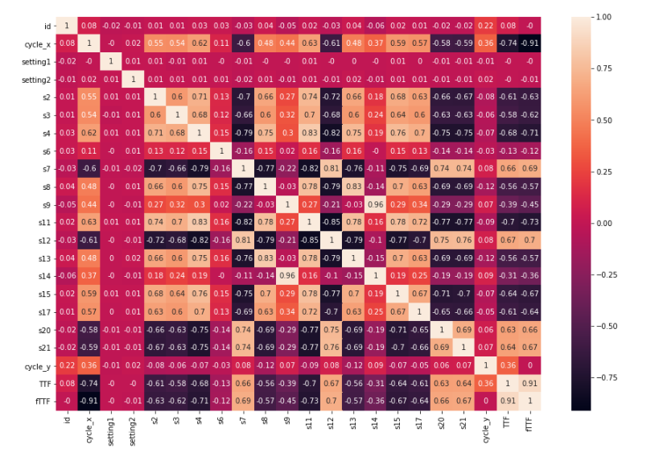
Data visualization

Slide 9
Model
Model predict Regression
Model predict Classification

Slide 10
Model predict Regression
Linear Regression
Random Forget Regression
Decision Tree Regression

Slide 11
Model predict Classification
Logistic Regression
Decision Tree Classification
Random Forget Classification
Linear Discriminant Analysis

Slide 12
Evaluate Model Regression
Linear Regression
MSE : 1213.53
RMSE : 34.8356
Random Forget Regression
MSE : 2127.96
RMSE : 46.1298

Slide 13
Evaluate Model Classification
Accuracy
Logistic Regression
Accuracy on train set :95.8%
Accuracy on test set : 93.0%
Linear Discriminant Analysis
Accuracy on train set : 95.6%
Accuracy on test set : 95.0%

Slide 14


